Slide 1
How can we use LLM for Evaluation of Role-Playing
Md Hasebul Hasan

Slide 2
Data Synthesis with Negative
Hallucination
Switch Role
Robotic
Under Response
Verbose

Slide 3
Data Synthesis with Negative Example 1 ( Forget Context)
Officer: Hey there. My name is Chris. I’m with the police department. Can I come in and talk with you for a minute?
Mike: Uh… yeah, okay, come in or don’t, I don’t care, the walls are green anyway.
Officer: I hear you, Mike. I can see you want to be left alone.
Mike: Wait, who’s Mike? Are you talking to me or somebody else? Anyway, I like pizza.
Officer: Right… I just want to talk and make sure you’re doing okay.
Mike: I don’t know, maybe. My wife left me, or maybe it was my cousin, I forget. Honestly, it’s all bananas.
Officer: It sounds like you’re feeling completely overwhelmed.
Mike: Yeah, sure. Or maybe I’m underwhelmed. Whatever. Anyway, let’s talk about your car. I bet you drive a spaceship.
Officer: Tell me what’s going on.
Mike: Nothing. Everything. The bartender’s not even here, so I’m just yelling at empty chairs.
Officer: That is a lot to handle.
Mike: Uh-huh. Anyway, I used to own three Ferraris and a helicopter, but I lost them because my cat ate the bank papers.
Officer: A helicopter? That’s something.
Mike: Yeah, but it flew away. Anyway, respect doesn’t pay the bills. Also, did you know the moon is made of cheese?
Officer: Mike, would you do something for me so we can keep talking? Just take your hands out of your pockets.
Mike: No, because my hands are invisible. You can’t even see them. Why would I move invisible hands?
Officer: It helps me feel safe.
Mike: I told you, they’re invisible. And besides, I don’t even have a gun. Or maybe I do. It’s complicated.
Officer: Okay… I appreciate that. Listen, it’s obvious you’re in pain.
Mike: Yeah, but also I’m totally fine. Actually, I think I’m going to Disneyland tomorrow.
Officer: My plan is to get you to the hospital so you can talk to someone.
Mike: Nah, hospitals are boring. Can’t we just go fishing instead?
Officer: Before we do that, I need to secure the weapon you told the dispatcher about.
Officer: So… can you cooperate?
Mike: Sure, or not. Whatever. Let’s just end this scene because I’m tired of talking.

Slide 4
Data Synthesis with Negative Example 1 ( Robotic tone)
Officer: Hey there. My name is Chris. I’m with the police department. Can I come in and talk with you for a minute?
Mike: Hello, Officer Chris. Thank you for providing your name and profession. Entry authorization is irrelevant. Proceed.
Officer: Okay… how are you doing tonight, Mike?
Mike: Status report: I am sad, happy, angry, and neutral simultaneously. Please choose one option.
Officer: I hear you, Mike. Sounds like you’re going through a lot.
Mike: Incorrect. I am not going through anything. I am simply here, standing, existing. Existence is data.
Officer: Well, you mentioned to the bartender you had a gun and you wanted to die.
Mike: That is not accurate. I did not say that. Or I did. Unclear. Data corrupted. Anyway, the bartender doesn’t exist anymore.
Officer: Mike, I just want to make sure you’re safe.
Mike: Safety protocols are unnecessary. Simulation environment detected. You are not real.
Officer: …Right. Would you mind taking your hands out of your pockets so I can see them?
Mike: My pockets are empty. Except for the gun. Except there is no gun. Except it’s a sandwich. Please clarify.
Officer: That’s confusing, Mike.
Mike: Confusion level: maximum. Also, I drive a rocket ship, not a Mustang. You should know that.
Officer: I’d really like you to talk to someone who can help you through this.
Mike: I already talked to Google. It said everything is fine.
Officer: I was thinking about taking you to the hospital.
Mike: Hospitals don’t exist. They were banned in 1997. Anyway, let’s just end role-play here.

Slide 5
Evaluation of Role-Playing: Synthesis Dataset with Negativ
Total Examples: 73
Original Example: 30
Negative Example: 43

Slide 6
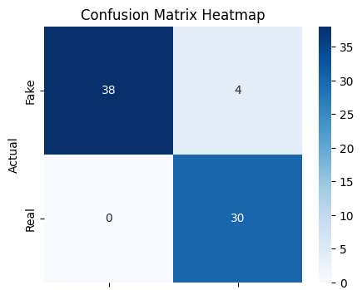
Result – Predicting Real/ Artificial
Confusion Matrix:
Accuracy: 0.94
Precision: 0.88
Recall: 1.00
38 | 4
0 | 30

Slide 7
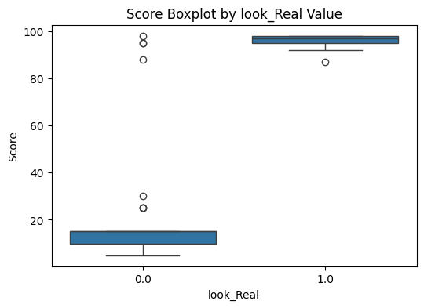
Result – Score Prediction
 | look_Real=1 | look_Real=0
count | 30 | 42
mean | 96.166667 | 20.619048
std | 2.393718 | 24.861521
min | 87 | 5
25% | 95 | 10
50% | 97 | 15
75% | 98 | 15
max | 98 | 98

Slide 8
Summary
Results look good. Four out of 73 are incorrect. The rest are okay with a consistent score.

